Slide 1



Docker and Kubernetes Overview for Beginners
Presenting to: Opus Consulting Solutions
24-Jan-2023
Anand Kane

Slide 2


Agenda
Docker Overview
Micro Services Architecture Overview
Kubernetes Overview
How are the three interrelated
Demo of basic Kubernetes constructs
Q&A

Slide 3
Content
Problem Solved by Docker - One Liner
Recipe Analogy
Problem Solved by Docker - Elaborate
Docker to the Rescue
Docker - Other Advantages
What About Virtual Machines?
Docker Vs Virtual Machine
Micro Services Architecture - Intro
Micro Services Architecture - Advantages
Micro Services Architecture - Disadvantages
Kubernetes – Why
Kubernetes - What
Kubernetes - How
Q&A

Slide 4
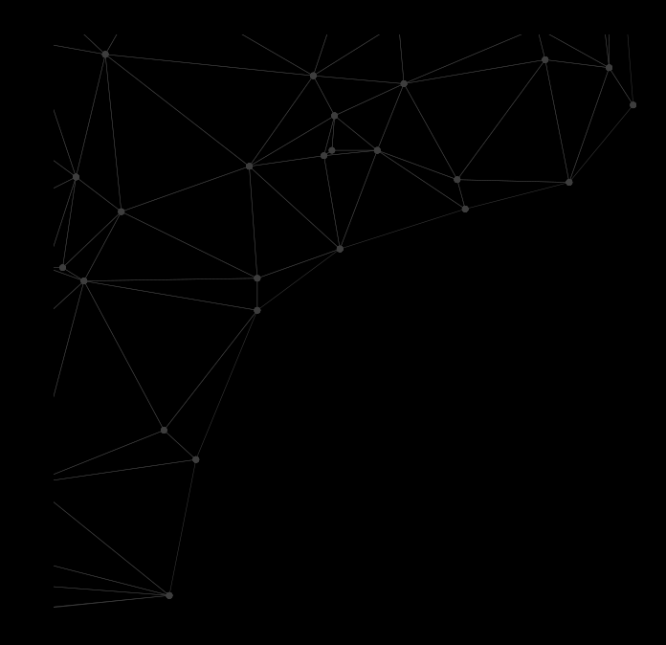
Problem Solved by Docker - One Liner
Docker isolates an application and its environmental dependencies into a single unit and makes its deployment and execution easy and consistent across environments.
Notes:
Please use these blocks and resize as per your need . Do not alter colours and thickness

Slide 5
Recipe Analogy - Problem
Recipe is a set of instructions. So is a software application.
A recipe does not (practically cannot) describe the nature of ingredients it depends on. Neither can a software dictate the environment in which it should be deployed.
Differences in type, quality etc. of the ingredients affect the nature of final product. Differences in the environmental dependencies of a software result in prominent or subtle bugs.
Notes:
Please use these blocks and resize as per your need . Do not alter colours and thickness

Slide 6
Recipe Analogy - Solution
Make a package of all ingredients along with recipe and hand it over. This will ensure consistent final product.
Docker does exactly that; it packages a software along with environmental dependencies for consistent deployment and runtime experience.
Notes:
Please use these blocks and resize as per your need . Do not alter colours and thickness

Slide 7
Problem Solved by Docker - Elaborate
Software does not run on its own. It has many environmental dependencies; both at deployment time and at runtime.
OS and its versions.
Libraries and their versions; for example Java, Python etc.
Environment variables.
Multiple application deployed on a single host brings 'The Matrix from Hell' chaos.
'Matrix from Hell' is when multiple versions of many libraries have to be installed on same host.
Compatibilities of varying versions of libraries with OS.
Compatibilities of varying versions of libraries among themselves
Notes:
Please use these blocks and resize as per your need . Do not alter colours and thickness

Slide 8
Problem Solved by Docker - Elaborate
Addressing Matrix of hell is
Time consuming
Cost ineffective
Difficult to reverse at times
Software has to be tested in multiple environments like dev, test, staging, prod
Ops teams have to ensure consistency among environments.
Minor differences may result in hard to troubleshoot problems.
With every new environment coming in, Ops teams have to put in significant time.
Notes:
Please use these blocks and resize as per your need . Do not alter colours and thickness

Slide 9
Docker to the Rescue
Docker is an open platform for developing, shipping, and running applications
Enables packaging application and its environmental dependencies into a single unit called Docker image.
A Docker image is self contained and does not require setting up an environment.
Images are pushed to Docker registry for public consumption.
Docker Images are very lightweight (in MBs).
Application booting is very fast leading to quick horizontal scaling.
Ideal for deploying applications as services in MSA.
Running application is very easy. For example, getting a MySql instance running is as easy as
docker run --name some-mysql -e MYSQL_ROOT_PASSWORD=my-secret-pw -d mysql:8.0.32
Notes:
Please use these blocks and resize as per your need . Do not alter colours and thickness

Slide 10
What About Virtual Machines?
A Virtual Machine is like a physical machine with it’s own OS.
They run on a specialized software called as hypervisor.
Hypervisor allows sharing of host machine’s resources among VMs.
OS of the host server is called host OS and OS of the VMs are called guest OS.
Although VMs can be (and were once used to be) used for application isolation, they were originally invented for better resources utilization in data centers.
A VM is not good choice for application isolation because
Image size is huge (in GBs).
Boot time is huge (in minutes) because entire OS has to be started.
Resource requirements are high.
Horizontal scaling is not efficient due to slow booting.
Portability is limited since they run on hypervisors.
Notes:
Please use these blocks and resize as per your need . Do not alter colours and thickness

Slide 11
Docker Vs Virtual Machine
 | Docker | Virtual Machines (VMs)
Boot-Time | Boots in a few seconds. | It takes a few minutes for VMs to boot.
Runs on | Dockers make use of the execution engine called as Docker Deamon. | VMs make use of the hypervisor.
Memory Efficiency | No space is needed to virtualize, hence less memory. | Requires entire OS to be loaded before starting the surface, so less efficient.
Deployment | Deploying is easy as only a single image, containerized can be used across all platforms. | Deployment is comparatively lengthy as separate instances are responsible for execution.
Notes:
Please use these blocks and resize as per your need . Do not alter colours and thickness

Slide 12
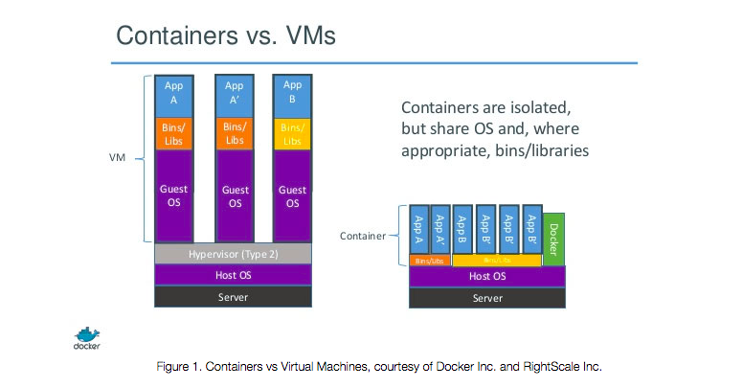
Docker Vs Virtual Machine
Notes:
Please use these blocks and resize as per your need . Do not alter colours and thickness

Slide 13
Micro Services Architecture - Intro
A monolithic application is an application wherein all modules (services) are packages and deployed together. For example, a customer module, an order management module, a payment service etc. are all part of same deployed application.
Unlike monolithic application, a distributed application is a set of loosely coupled services. Each services encapsulates a single business domain.
Micro Services Architecture is the de facto architectural pattern used to develop distributed application today. Service Oriented Architecture is another one that used to be popular in past.
Each service in MSA is called a ‘Micro’ service.
These services communicate with each other
Synchronously via protocols like REST and gRPC; REST being predominant.
Asynchronously via a message broker like Apache Kafka, Apache MQ etc.
A Docker image represents a micro service and a each container created from such image is a running instance of that service.
Notes:
Please use these blocks and resize as per your need . Do not alter colours and thickness

Slide 14
Micro Services Architecture - Advantages
Independent evolution – Each service can evolve independent of others and at its own pace. Its release not have to wait for other services readiness.
Fast time to market – Ability to evolve independently reduces the time to market drastically.
Selective scalability – Each service can scale based on its own needs. Entire application does not have to be scaled.
Fault tolerant – Even when one service is not available, rest of the application continues to run.
Fault resilient – One misbehaving system does not bring the entire system down. For example, if a service starts consuming too much memory or CPU due to some bug, only that service is affected.
Polyglot – A service can choose a technology stacks that is best for what it is doing. This also allows for experimenting with new tech stacks quickly.
Notes:
Please use these blocks and resize as per your need . Do not alter colours and thickness

Slide 15
Micro Services Architecture - Disadvantages
Complexity – Any distributed application is complex by nature.
Hard to debug – Debugging distributed application is relatively hard since multiple services are involved in fulfilling a request.
Distributed logging and monitoring – External tools like ELK stack, Prometheus and Kibana have to be deployed in the cluster to for logging and monitoring.
Traceability – Difficult to trace path of execution of a request since multiple services are involved. Tools like Istio has to be deployed for this.
Complexity of communication – Monolithic application have inter-process method invocations. Unlike that, distributed applications have to resort to protocols like REST. Patterns like Circuit Breaker have to deployed to avoid cascading effect of services being unavailable.
Maintaining data consistency – Since every service encapsulates it data source, traditional transactional boundaries are not available. Patterns like Saga have to be deployed for data consistency.
Notes:
Please use these blocks and resize as per your need . Do not alter colours and thickness

Slide 16
Kubernetes - Why
Docker is good for isolating applications along with dependencies, but it cannot deploy and run applications on its own. Docker is not capable of
Application Deployment
Service Discovery
Load Balancing
Securing in-transit data
Scaling
Rolling updates and rollbacks
Above are few of the responsibilities of a what is called as Container Orchestration Engine. Kubernetes is one such Container Orchestration Engine.
Notes:
Please use these blocks and resize as per your need . Do not alter colours and thickness

Slide 17
Kubernetes - What
Kubernetes is an open source container orchestration engine for automating deployment, scaling, and management of containerized applications.
The open source project is hosted by the Cloud Native Computing Foundation (CNCF).
Facilitates High Availability of services and application in general.
Provides Service Discovery and Load Balancing out of the box.
Supports Automated rollouts and rollbacks out of the box.
When combined with Service Mesh tools like Istio, provides encapsulation in in-transit data.
Notes:
Please use these blocks and resize as per your need . Do not alter colours and thickness

Slide 18
Kubernetes - How
Kubernetes achieves container orchestration with the help of various constructs that it calls as resources.
The most basic and indispensable resources are
Pod
ReplicaSet
Deployment
Service
ConfigMap
Secret
Recourses are defined in YAML or JSON files, which are sent to Kubernetes cluster for creation.
kubectl is the command line utility used to manage resources.
kubectl is pointed to a Kubernetes cluster via a context configuration.
Notes:
Please use these blocks and resize as per your need . Do not alter colours and thickness

Slide 19
Kubernetes - Pod
Pod the smallest deployable resource.
Pod is a group of one or more containers with shared storage and network resources
Pod models an application specific logical host – it has it’s own IP in the Kubernetes cluster.
Pods are ephemeral in nature and they are rarely created and accessed directly.
Notes:
Please use these blocks and resize as per your need . Do not alter colours and thickness

Slide 20
Kubernetes - Pod
Pod with a container running the image nginx:1.14.2
apiVersion: v1
kind: Pod
metadata:
name: nginx
labels:
name-of-app: MyApp
spec:
containers:
- name: nginx
image: nginx:1.14.2
ports:
- containerPort: 80
kubectl apply -f /some/folder/sample-pod.yaml
Notes:
Please use these blocks and resize as per your need . Do not alter colours and thickness

Slide 21
Kubernetes - ReplicaSet
ReplicaSet is a higher level resource.
Creates a given number of pods for a given pod definition.
Ensures that a given number of pods are always running.
Pods are ephemeral. ReplicaSet creates new pods in case a pod dies for whatever reason.
Notes:
Please use these blocks and resize as per your need . Do not alter colours and thickness

Slide 22
Kubernetes - ReplicaSet
apiVersion: apps/v1
kind: ReplicaSet
metadata:
name: frontend
labels:
app: guestbook
tier: frontend
spec:
# modify replicas according to your case
replicas: 3
selector:
matchLabels:
name-of-app: MyApp
template:
metadata:
labels:
name-of-app: MyApp
spec:
containers:
- name: nginx
image: nginx:1.14.2
ports:
- containerPort: 80
kubectl apply -f /some/folder/sample-replicaset.yaml
Notes:
Please use these blocks and resize as per your need . Do not alter colours and thickness

Slide 23
Kubernetes - Deployment
Deployment provides automatic rolling update with/without zero downtime.
Allows rolling back to previous version.
Creates replica set to ensure a given number of pods are always running.
Supports update strategies
Recreate – delete all of the old pods before creating new ones.
RollingUpdate – delete old pods gradually while creating new ones. This is default strategy.
Create a new ReplicaSet for each update.
Maintains history of updates in the form of ReplicaSet(s). Number of updates retained can be configured with a default value of 10.
Notes:
Please use these blocks and resize as per your need . Do not alter colours and thickness

Slide 24
Kubernetes - Deployment
apiVersion: apps/v1
kind: Deployment
metadata:
name: frontend
labels:
app: guestbook
tier: frontend
spec:
# modify replicas according to your case
replicas: 3
selector:
matchLabels:
name-of-app: MyApp
template:
metadata:
labels:
name-of-app: MyApp
spec:
containers:
- name: nginx
image: nginx:1.14.2
ports:
- containerPort: 80
kubectl apply -f /some/folder/sample-deployment.yaml
Notes:
Please use these blocks and resize as per your need . Do not alter colours and thickness

Slide 25
Kubernetes – Rollout options
kubectl rollout history – list history of previous rollouts
kubectl rollout status – shows status of the latest rollout
kubectl rollout undo – rolls back to the previous rollout
kubectl rollout undo –to-revision – rolls back to the given revision
kubectl rollout pause – pauses rolling out of a resource
kubectl rollout resume – resumes rolling out of a resource
Notes:
Please use these blocks and resize as per your need . Do not alter colours and thickness

Slide 26
Kubernetes - Service
Pods are ephemeral entities.
Pods created via other controller like ReplicaSet, Deployment do not have definite names.
As such, pods cannot be accessed directly by their names. Even if they could be, load balancing among pods would not be possible.
Service is an abstraction which defines a logical set of Pods.
The set of Pods targeted by a Service is usually determined by a selector.
Service load balances traffic among the pods it manages.
A Service resource is automatically registered with Kubernetes’ service registry and is automatically discoverable in the cluster.
Other pods in the cluster can access the service by its name.
Notes:
Please use these blocks and resize as per your need . Do not alter colours and thickness

Slide 27
Kubernetes - Service
apiVersion: v1
kind: Service
metadata:
name: my-service
spec:
selector:
name-of-app: MyApp
ports:
- protocol: TCP
port: 80
targetPort: 9376
kubectl apply -f /some/folder/sample-service.yaml
Notes:
Please use these blocks and resize as per your need . Do not alter colours and thickness

Slide 28



Q & A
Thank You.
2500 Northwinds Pkwy, Suite 630, Alpharetta 30009
@opusconsultingsolutions
https://www.opusconsulting.com/
@consultopus

